Slide 1


Coronavirus disease (COVID-19)
IPC & HEALTH FACILITY SIMULATION EXERCISE

Slide 2
Agenda
Part 1:
08:45
09:00
09:10
09:15
10:45
11:00
12:30
13:00
13:00
Part 2:
09:00
09:15
10:30
10:45
11:30
12:00
12:30
Registration Introduction
Exercise Objectives and how to play Table-top Simulation
Coffee break (15 min)
Table-top Simulation Hot-wash
Close part 1 Lunch
Re-cap
Gaps analysis & action planning (group work)
Coffee break (15 min)
Action planning continued (group work)
Consolidation in plenary session Wrap up and next steps
Closing

Slide 3
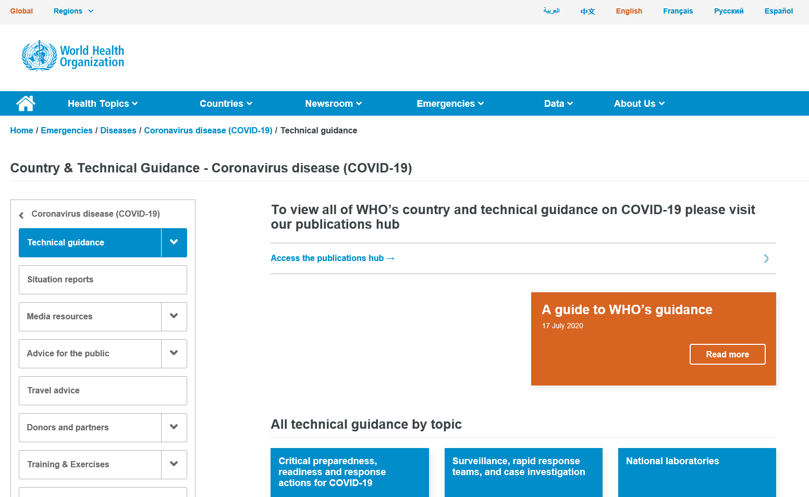
Guiding Preparedness and Response
WHO, providing up to date, accurate advice
During health emergencies like the COVID-19 pandemic, one of WHO’s most vital roles is to gather data and research from around the world, evaluate it, and then advise countries on how to respond.
Since January 2020, WHO has published more than 100 documents about COVID-19. Of these, more than half are detailed technical guidance, on how to find and test cases, how to provide safe and appropriate care for people depending on the severity of their illness, how to trace and quarantine contacts, how to prevent transmission from one person to another, how to protect health care workers, and how to help communities to respond appropriately.
20 October 2020
Notes:
WHO teams work with experts from around the world to develop this guidance. Together, the experts review reports, studies, presentations by countries, they analyse trends, consult further expert groups and then agree on the best approach. The guidance is meant for health decision makers who adapt the information for their country and context. As new scientific knowledge emerges, the documents are updated.

Slide 4
What is a Table-Top Exercise (TTX)?
A tabletop exercise (TTX) is a discussion based event that uses a progressive simulated scenario, together with series of scripted injects, to make participants consider the impact of a potential health emergency on existing plans, procedures and capacities.
“A TTX simulates an emergency situation in an informal, stress-free environment.”
-WHO Exercise Manual, 2017
NOVEL CORONAVIRUS (COVID-19)
20 October 2020
page 4

Slide 5
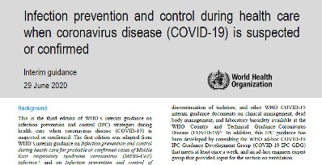
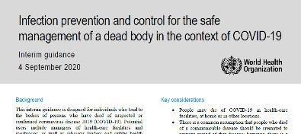
Design & Purpose
Exercise Design
This exercise is based on the latest WHO IPC guidance for COVID-19, including:
Infection prevention and control during health care when
coronavirus disease (COVID-19) is suspected or confirmed (interim guidance 29 June 2020)
Infection prevention and control for the safe management of a dead body in the context of COVID-19 (interim guidance 4 September 2020).
Purpose
Through facilitated group discussion, the exercise aims to
examine the implementation of IPC strategies required to prevent or limit transmission of COVID-19 in health care facilities.
COVID-19
page 5
Notes:
Resources available:
• the Health Care Facility assessment tool - https://www.who.int/publications/i/item/WHO-2019-nCoV-HCF_assessment-IPC-2020.1
• the Health Care Facility Safe Environments assessment tool - https://www.who.int/publications/i/item/WHO-2019-nCoV-HCF_assessment-Safe_environment-2020.1

Slide 6
General objectives of the TTX
General Objectives
Share information on practices on IPC associated with health care for suspected or confirmed cases of COVID-19 and how those precautions could evolve based on the progress of the event in your facility.
Identify challenges in bed occupancy and staff management between different departments.
Discuss procedures for the collecting and handling of laboratory specimens from COVID-19 patients
Reassess the dead body management protocols
Identify areas for action in your facilities based on the issues explored in the scenario and on how the scenario could play out in your health facility.
COVID-19
page 6

Slide 7
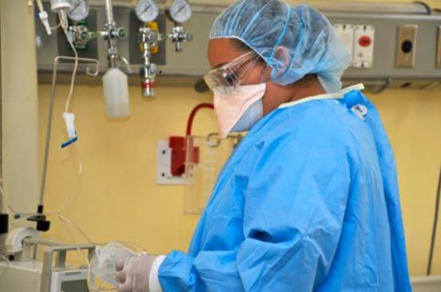
Rules of the TTX
Not an individual test
Respect the views of others
Consider the scenario as it would impact your assigned unit.
Use your existing plans, guidelines and regulations to inform your responses
Focus on solutions and forward planning.
COVID-19
page 7

Slide 8
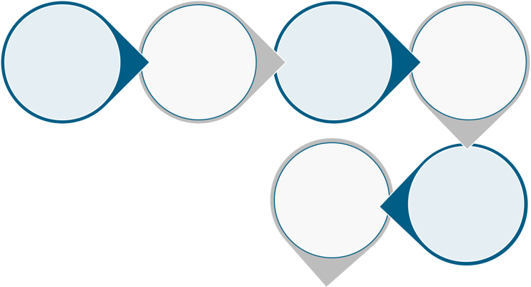
Table-Top Exercise: How to Play
Questions & Discussion | Scenario update | Questions & Discussion
(1) | Questions | (2)
Scenario
& Discussion (3)
Scenario update
Review of needs in health facility
Hot-Wash
COVID-19
page 8

Slide 9

Questions
ANY QUESTION BEFORE WE START
SIMULATION EXERCISE
COVID-19
20 October 2020
page 9

Slide 10
Coronavirus disease (COVID-19)
IPC & HEALTH FACILITY SIMULATION EXERCISE

Slide 11


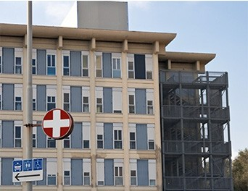
Scenario
SIMULATION ONLY
Heroes Hospital is a 300-bed tertiary facility in the capital with 18 ICU beds. The hospital operates on average at 90-95% capacity (floor plan in handouts.)
The hospital was highly impacted during the first COVID-19 outbreak from March-April 2020. During that period, 347 patients were hospitalized with COVID-19, of which 29 died, including 2 children with underlying health conditions.
Since then, the government has implemented strict public health and social measures, which in effect have decreased the number of COVID-19 patients.
Over the past few months easing of restrictions has led to an increase in infections and this has been reflected by an increase of COVID-19 patients.
COVID-19
20 October 2020

Slide 12

Session 1
Questions for discussion
30 mins
Based on your plan and procedures what screening and triage procedures should be in place in this hospital? And is it enough?
As the SARS-CoV-2 virus is likely to stay with us for a long time, what would be the IPC recommendations for staff and patients?
What isolation and cohorting measures should be in place to manage infectious patients?
What kind of equipment, training or other activities would keep staff alert to the need for IPC measures in the presence of high COVID-19 infections?
What kind of environmental cleaning and engineering control systems are implemented?
Are any administrative controls needed at this stage, and if so what would these be?
How will you ensure facility policies will be followed and how do you deal with non-compliance?
COVID-19
20 October 2020

Slide 13

Scenario update
SIMULATION ONLY
Increasing numbers of COVID-19 patients are being admitted to hospital.
Suspect cases are put in isolation and tested for the novel virus.
The ICU is almost fully occupied with only 2 beds remaining free.
Hospital management is considering the set-up of an isolation ward/field hospital
A number of health care staff have
developed COVID-19 symptoms and are absent and staying at home
COVID-19
20 October 2020

Slide 14
Session 2
Questions for discussion
30 mins
How will you confirm if suspect patients are infected with the novel Coronavirus?
Where will the samples have to be sent to test for COVID-19 and how long will it take to receive results back?
To what unit will suspected and confirmed patients be admitted?
What considerations would you recommend for clinical management and isolation pathways?
Would the current situation pose any challenges in patient bed occupancy and staffing?
How could the ICU capacity be enhanced?
How will you manage healthcare acquired infections, contact tracing and management of contacts?
8. What other measures might be implemented regarding this situation?
COVID-19
20 October 2020

Slide 15
Session 2- Hospital administration meeting
Hospital administration calls a meeting to review the process in place in case numbers continue to increase. Discuss the situation and determine priority actions including:
  Activation of the health facility surge plan, including respiratory support, PPE supplies, IPC, and mental health support for staff
  Equipment needs
  Training needs
  Staffing needs
  Environmental cleaning requirements
  Bed occupancy and staffing management in parallel with isolation needs
  Patient relocation to other hospitals
How will this plan be communicated to external audiences (e.g. media, patients & general public?)
60 mins
COVID-19
20 October 2020

Slide 16
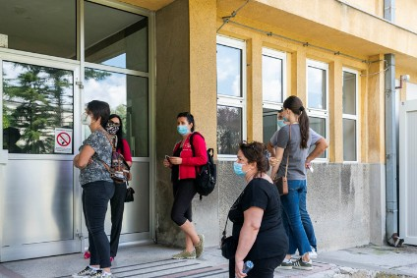
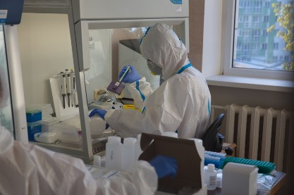
Scenario update
SIMULATION ONLY
Five days later the ICU capacity has been extended with 40% extra capacity (e.g. 8 beds)
Regular health care has been impacted and some patients have been moved to other hospitals.
Other wards have been repurposed to free up space for suspected and confirmed patients
Health care staff have been trained to take care of COVID-19 patients.
20% of the health care staff working in the hospital have been infected with the SARS-CoV-19 virus.
Unfortunately, several patients have died in the last few days.
COVID-19
20 October 2020

Slide 17
Session 3
Questions for discussion
30 mins
How will you mitigate the risk of infection for your front line health care workers?
How will internal staff contacts of infected health workers be managed, including anticipating a shortage of available health workers, and a safe return to work strategy for infected health workers?
How will ambulation/rehabilitation of patients work to facilitate discharge planning?
How will dead bodies be managed? What procedures are to be followed?
How will you prepare and pack the body for transfer from the hospital to an autopsy unit, mortuary, crematorium or burial site?
COVID-19
20 October 2020
Notes:
Resource available:
the Management of Infected Health Workers document, also included in this document are screening considerations that participants may want to consider in their local contexts - https://www.who.int/publications/i/item/10665-336265

Slide 18
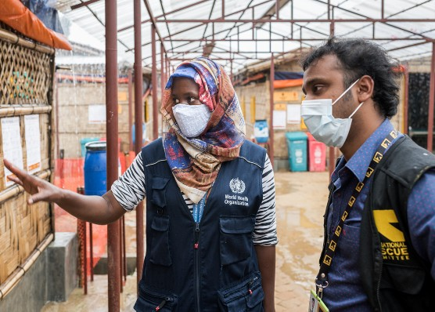
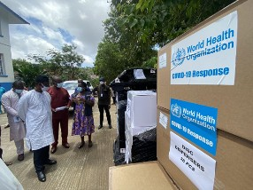
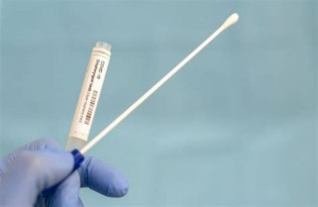
ENDEX
Participant Feedback
COVID-19
20 October 2020

Slide 19
Hotwash/Review of needs
75 mins
In groups, divide a piece of paper into three sections.
Review the Readiness Checklist, your plans and notes from your TTX
Discuss and write your points in each of the sections to answer:
  What worked well? (Achievements)
  What was challenging? (Challenges)
  Recommendations? (and prioritize, to identify your top 3)
Review strengths & gaps
Check assumptions
Propose ideas to enhance your systems, plans & Procedures
ACTION PLAN
TASKS:
Note: the action plan will be done in the next session
NOVEL CORONAVIRUS (COVID-19)
20 October 2020

Slide 20



Action Plan
Key Challenge/ Gap
Proposed Solution
Timeline for Resolution
Responsibility
45 mins
Notes:
Break down in groups.
Prioritisation of findings into actions
Action
Reason why a priority?
Who is responsible for the action?
What resources are required?
By when?
Each group rapporteur to provide a 5 minute summary of the findings of the group.

Slide 21
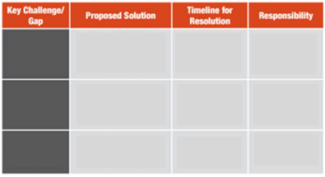
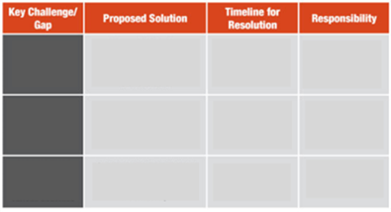
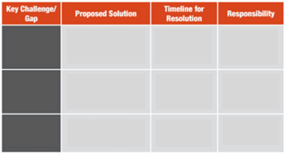
Consolidation

Slide 22

Next steps and wrap up
NEXT STEPS

Slide 23
WHO COVID-19 Partners Platform
The COVID-19 Partners Platform supports transparency, collaboration, and efficiency for countries, UN agencies, implementing partners, and donors in their COVID-19 response.
In the country checklist please update the indicator related to pillar 6: IPC when this Simulation Exercise has been successfully conducted.
For more information visit: https://covid19partnersplatform.who.int/
Notes:
Kindly inform the WHO Simulations/Preparedness focal point in your country once you have conducted the exercise and share the exercise report.
Email address of WHO Preparedness/Simulation focal point is; XXXXX
Phone number; XXXX

Slide 24



THANK YOU!
For SimEx technical support,
please contact your WHO country office or regional office focal point:
AFRO: stephenm@who.int
EMRO: samhourid@who.int
EURO: schmidtt@who.int; rashforda@who.int
PAHO: andragro@paho.org
SEARO: hkatom@who.int; htikem@who.int
WPRO: eshofoniea@who.int;
WHO RESOURCES
WHO COVID-19
Emergency webpage
More information on coronavirus
WHO resources on
simulation exercises
Scan or Click
Scan or Click
Scan or Click
Notes:
Break down in groups.
Prioritisation of findings into actions
Action
Reason why a priority?
Who is responsible for the action?
What resources are required?
By when?
Each group rapporteur to provide a 5 minute summary of the findings of the group.

